Slide 1
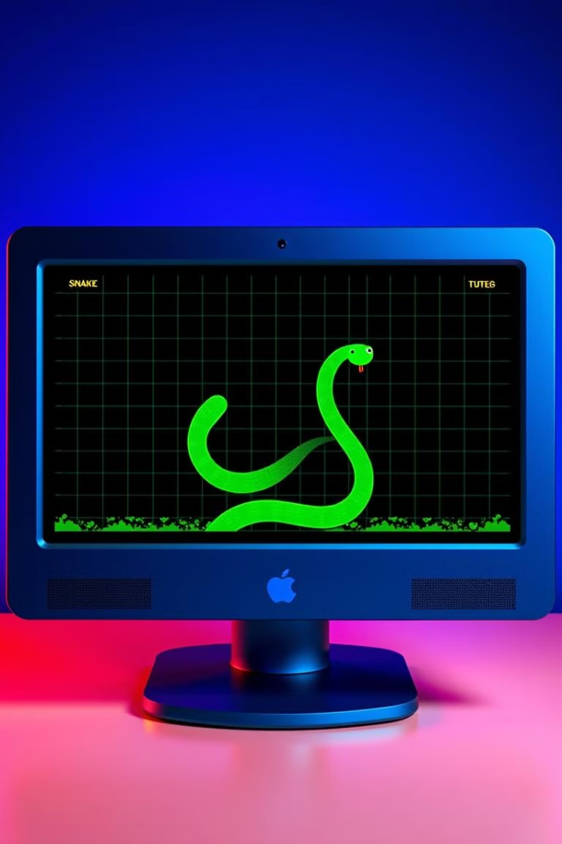

Python Snake Game Development: From Code to Play
In this presentation, we'll journey into the world of Python programming and game development by creating a classic Snake game. We'll explore the technology, packages, and methods used to bring this project to life.
Tech titans
Srilakshmi
Hannah
Gowtham
Sanjay

Slide 2

Problem Statement: The Challenge of Creating a Snake Game
Our goal is to develop a basic Snake game using Python. This involves creating a game board, controlling a snake, generating food, and detecting collisions. We aim for a functional and engaging experience.
The game will feature a snake that moves around a defined board, consuming food items to grow. The snake's movement is controlled by the player, and the game ends when the snake collides with the boundaries or itself.

Slide 3





Introduction: Building Blocks of the Snake Game
Game Board
1
The foundation of the game, defining the playing area.
Snake
2
The main actor, controlled by the player.
Food
3
The target for the snake to consume.
Score
4
Tracks the player's progress.
Game Over
5
The end condition of the game.

Slide 4
Technologies Used: The Tools for Development
Python
Visual Studio Code
The programming language, providing the foundation for our game logic.
The development environment, offering a user-friendly interface for coding and debugging.

Slide 5
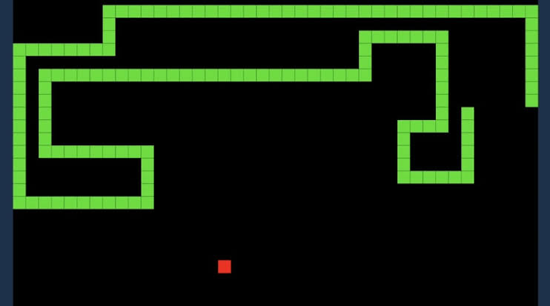
Software Requirements: Essential Components
Python 3.x
Pygame
The latest version of Python, for compatibility with libraries.
A library for creating multimedia applications, essential for graphics and sound.

Slide 6
Packages and Methods: Core Functionality
1
Pygame Initialization
2
Game Loop
Setting up Pygame to manage the game environment.
The main loop that controls the game's execution.
3
Snake Movement
4
Food Generation
Managing the snake's direction and position.
Creating random food locations on the board.
5
Collision Detection
6
Game Over Logic
Checking for collisions between the snake and the boundaries or itself.
Handling the end of the game and displaying the score.

Slide 7
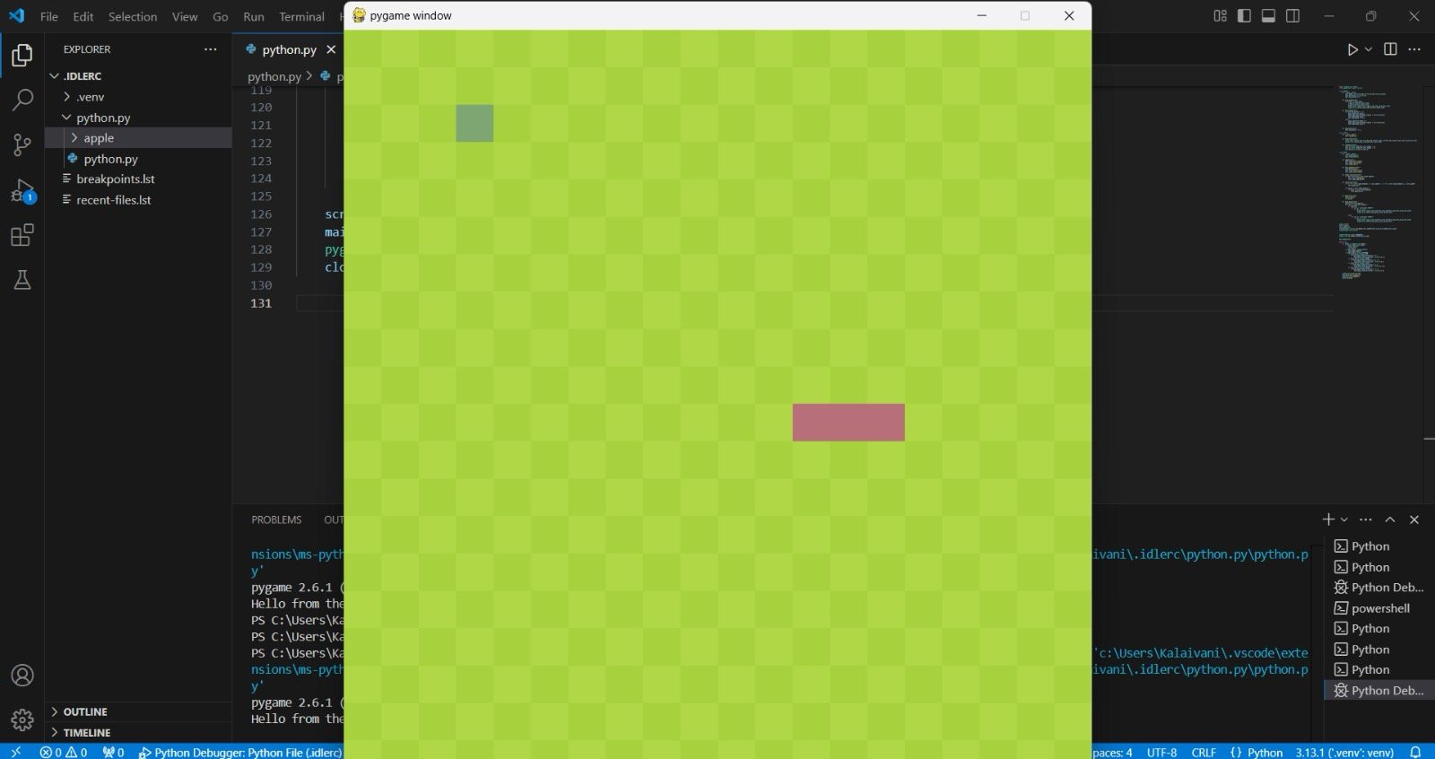
Sample Output: Visualizing the Game in Action

Slide 8
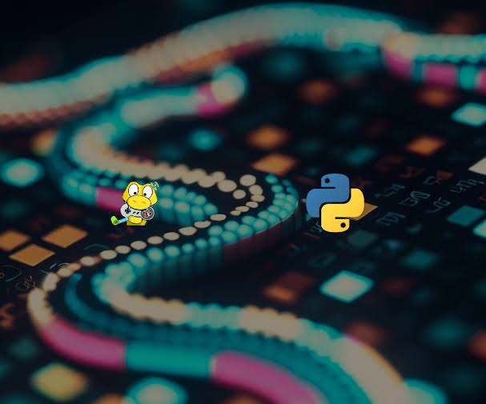



Conclusion: A Successful Snake Game Development
Code Mastery
Game Functionality
We've gained practical Python programming experience and mastered the basics of game development.
We've created a functional Snake game with engaging gameplay and a visually appealing design.
Knowledge Growth
We've expanded our understanding of programming, libraries, and game development principles.

Slide 9
Key Takeaways: The Benefits of This Project
Problem Solving
1
We've learned to break down complex tasks into smaller, manageable steps.
Logical Thinking
2
We've developed our ability to think logically and solve problems through code.
Creativity
3
We've explored creative possibilities in game design and coding.
Persistence
4
We've gained valuable experience in overcoming challenges and persisting through development.

Slide 10




Next Steps: Continuing the Game Development Journey
Game Enhancements
Implement more advanced features like power-ups, different game modes, or multiplayer support.
Visual Design
Improve the visual appeal of the game with more detailed graphics, animations, and sound effects.
New Game Concepts
Explore different game ideas and apply your Python skills to create new, exciting games.

